Slide 1
Let us sing praises to the King of Kings

Slide 2
Our greeters today are
Charlotte Stevens
&
Nancy Green

Slide 3
Our flowers this morning are given by
Tracey Rogers
In memory of her Dad, Woodrow Rogers Sr.
in honor of his birthday, March 17th

Slide 4
The Board of Worship serves coffee fellowship each week, prior to service at 9:15

Slide 6
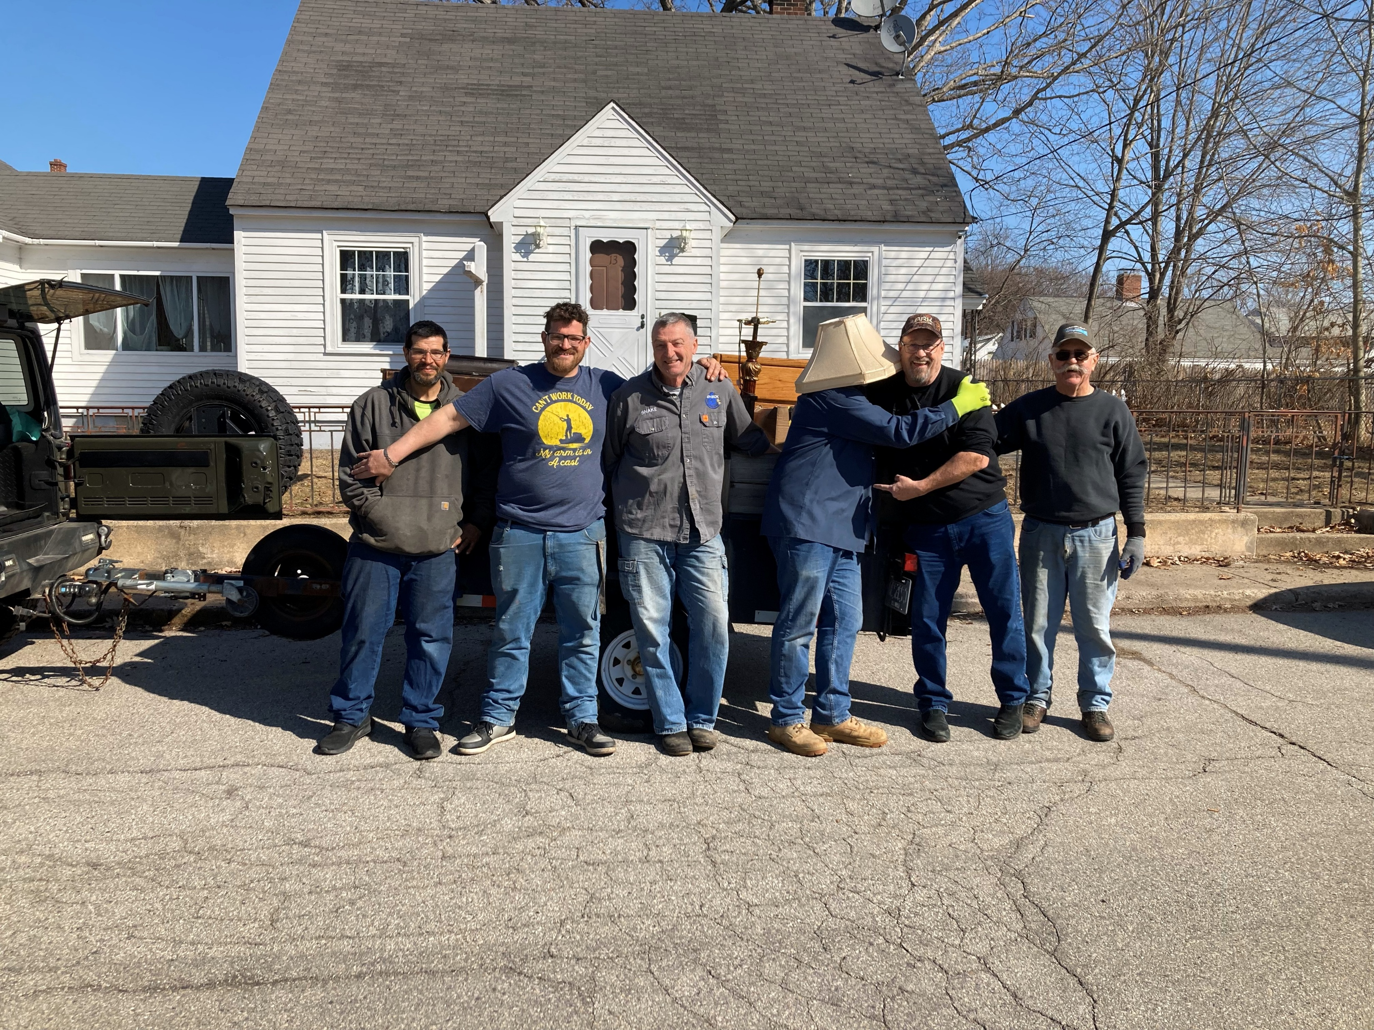
Divine moving company sharing the light of Christ. Where’s Pastor Mike?

Slide 7
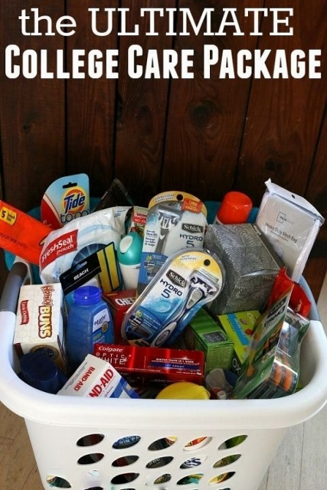
The Board of Mission is collecting for our college outreach boxes.
Please see the mission page of the bulletin for great ideas submitted by the Board!
Deadline is
March 30 for
shipping April 2nd

Slide 8
You are invited to a special movie next Sunday
March 23rd at 3:00.
The movie is at Smitty’s but reservations are required.
The Story of Possum Trail presented by Angel Studios

Slide 9
For those that didn’t get a Lenten devotional and wanted one:
You can order an e-copy at the below address for .99
https://www.christianbook.com/the-easter-code-booklet/o-s-hawkins/9781400211487/pd/211487?event=BRSRCG|PSEN

Slide 10
The Sanford/Springvale food pantry is in need of:
The food pantry is in need rice, mayonnaise, soups, baked beans, and jams and jellies.

Slide 11
Please join us Wednesday evenings at 6:00 for a soup supper followed by a Lenten worship service at 6:30

Slide 12
We are now accepting small items for the yard sale. By small items we mean anything that would fit in a banana box.
Please leave your items in the room behind the Keating Room downstairs.
Any questions, please see Carolyn or Pastor Mike

Slide 13
There is a sign-up sheet on the piano for those who want to have tulips placed on the altar for Easter Sunday. If you would like to put them in memory or honor of someone, please note that on the sign-up sheets.
The cost is
12.00 per tulip

Slide 14
The Board of Mission and Outreach invites you to participate in the America for Christ Offering.
There are envelopes in the pews for your convenience.

